Slide 1

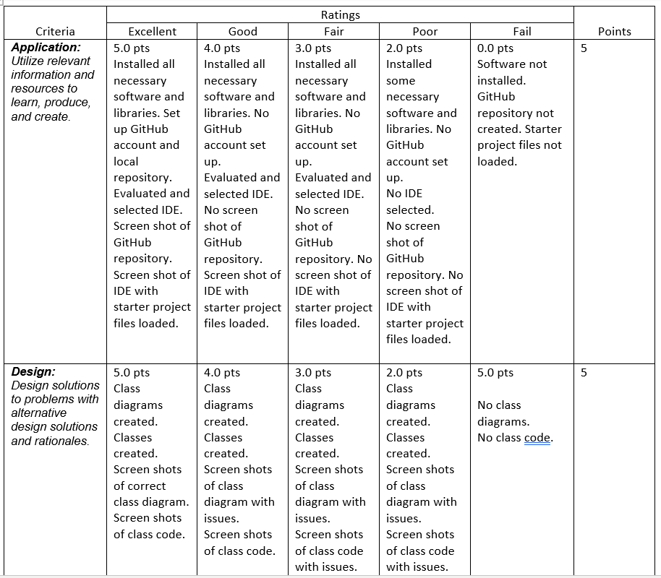
Final Project Deliverables
Rubric
Slides
Title
Introduction
Slides for Each Project Module
Description of Module
Results (Screen Shots)
Challenges
Career Skills Developed
Conclusion
Professional Quality
Final Program Pushed to GitHub
Project Posted on Portfolio site with Link

Slide 2
CEIS 150 Final project

Slide 3
Introduction
This class project was to create a program that can create stocks, save the stock data, extract stock data.
After the stocks have been entered, the data has been analyzed with data analytics.

Slide 4
CEIS150 Module 1
Software Environment Setup

Slide 5
Rubric
Activity | Requirement(s)
GitHub Repository | Picture of GitHub repository page.
Development Environment and Code File | Screenshot of software installed with Starter Files loaded.

Slide 6
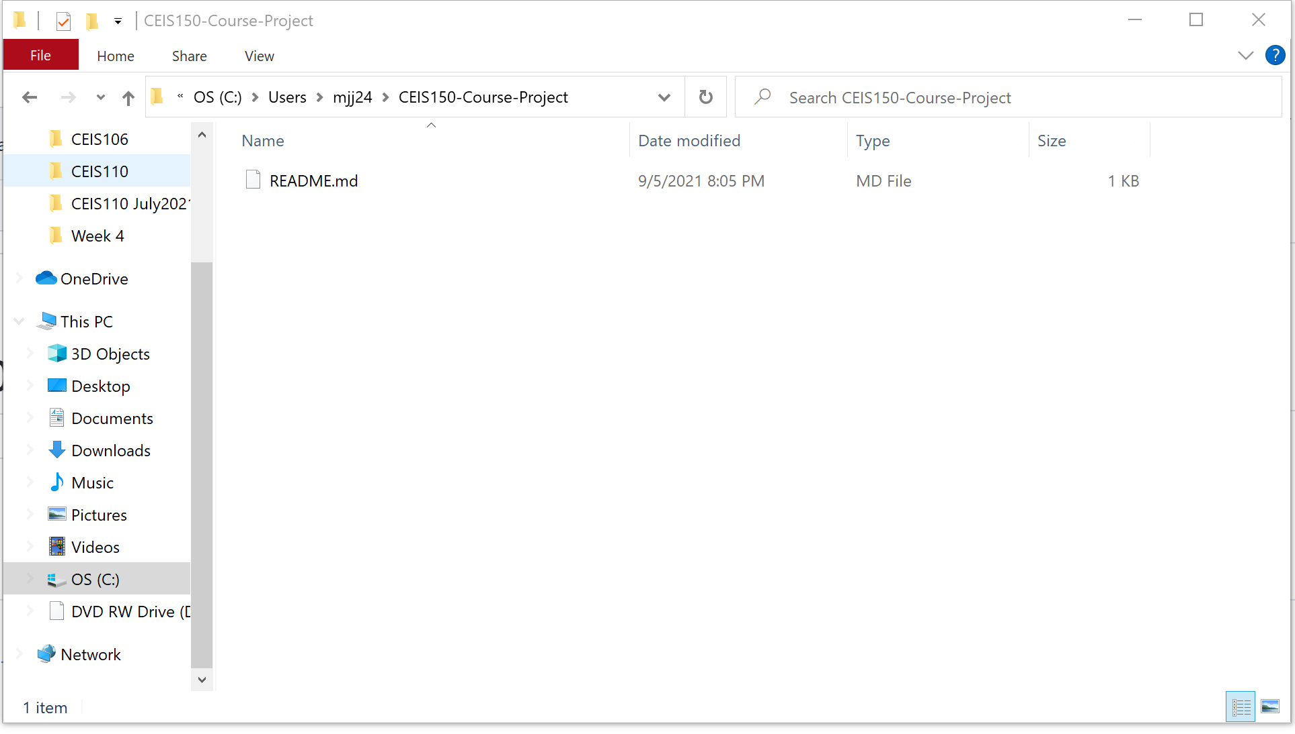
GitHub
Screen shot of GitHub project repository.

Slide 7
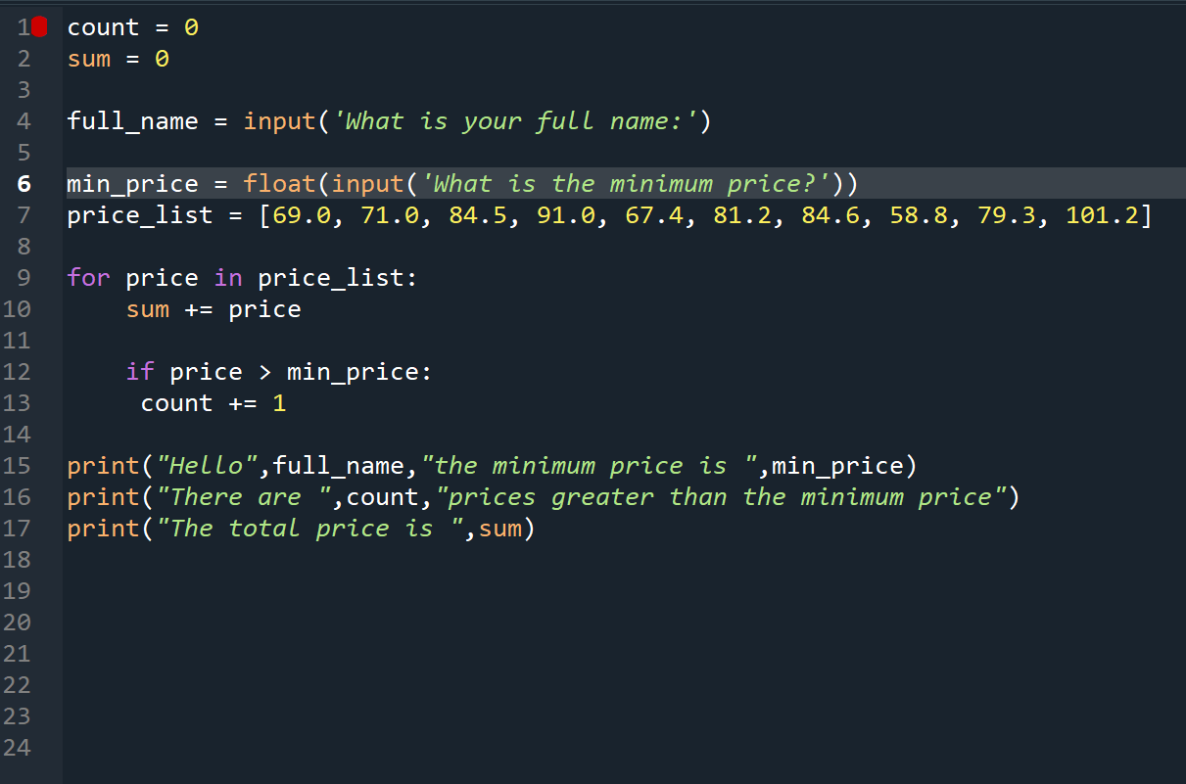
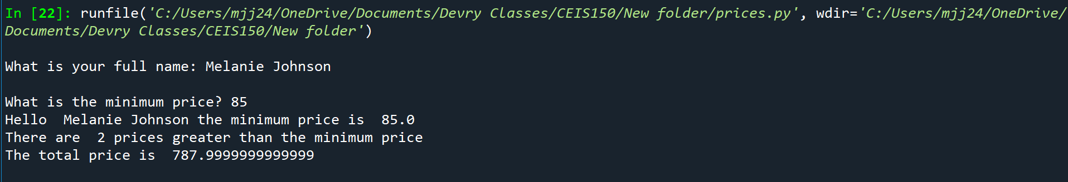
IDE & Code
Screen shot of your IDE (Spyder or VS Code) with the Code loaded.

Slide 8
CEIS150 Module 2
Class Diagrams
Class Coding
Unit Testing

Slide 9
Rubric
Activity | Requirement(s)
Class Diagram | Class Diagram
Class Code | Screen Shot of Class Code
Unit Test | Screen Shot of Unit Test

Slide 10
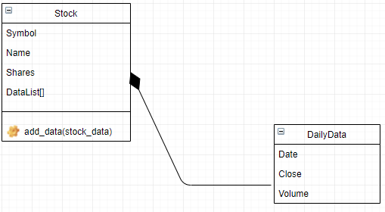
Class Diagram
Paste your Visio Class Diagram

Slide 11
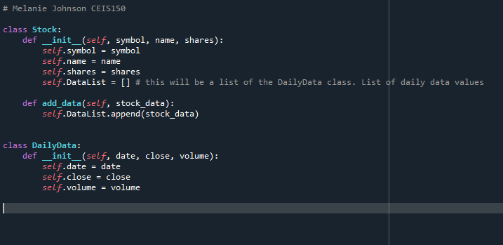
Class Code
Screen Shot of your stock_class.py file.

Slide 12
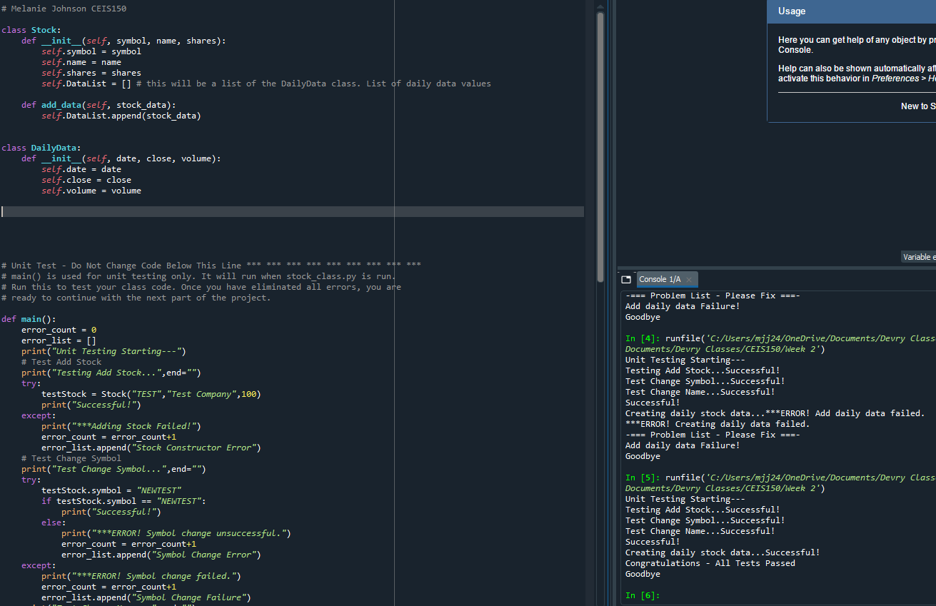
Unit Test
Screen Shot of your successful unit test.
Notes:
Had troubles with my test running successful. It was having an error with the DataList which was drawn from the class DailyData. I went through my class and realized I put the word data instead of date. So when I ran my test it failed since I had a typo error.

Slide 13
CEIS150 Module 3
Text-Based User Interface
Summary Report

Slide 14
Rubric
Activity | Requirement(s)
Adding a Stock | Screen Shot of adding stock data
Listing all Stocks | Screen Shot of listing 3 stocks
Daily data | Screen Shot of adding daily data

Slide 15
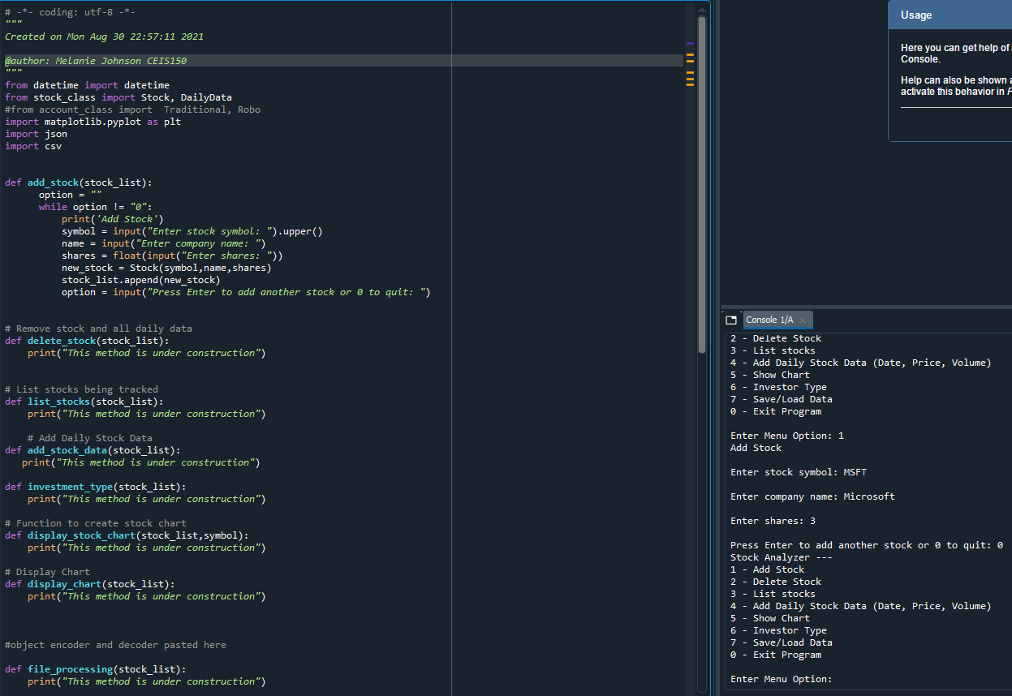
Adding a Stock
Paste a screen shot of your working Stock program.

Slide 16
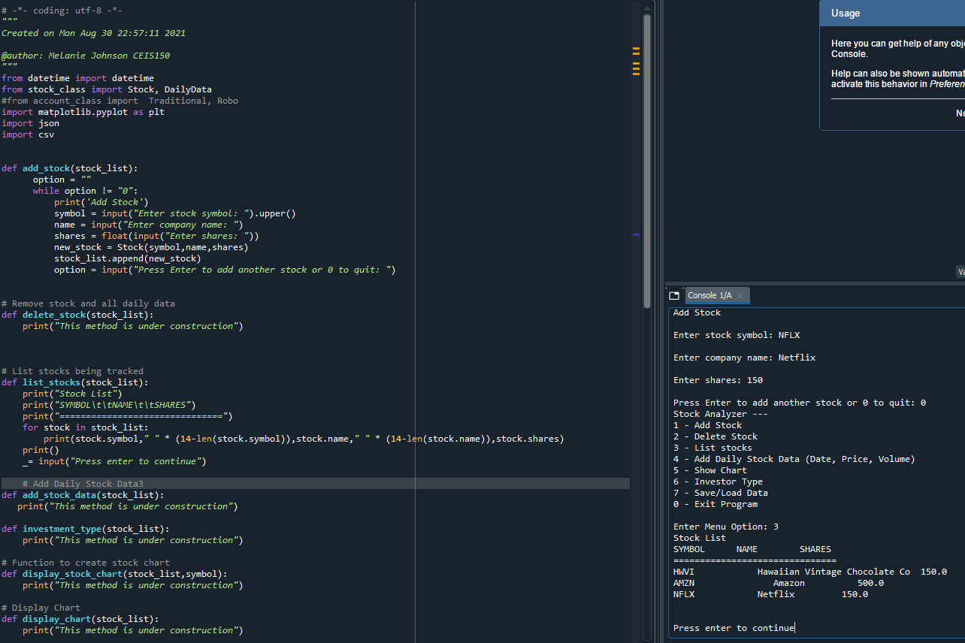
Listing 3 Stocks
Paste a screen shot of your working Stock program.

Slide 17
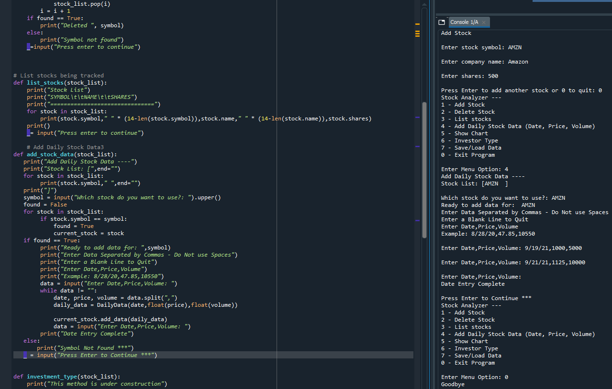
Daily Data
Paste a screen shot of your working Stock program.

Slide 18
CEIS150 Module 4
Inheritance
Summary Report

Slide 19
Rubric
Activity | Requirement(s)
Inherited classes | Screen shot of classes
Unit Tests | Screen Shot of unit tests working
Main program | Screenshot of classes in main

Slide 20
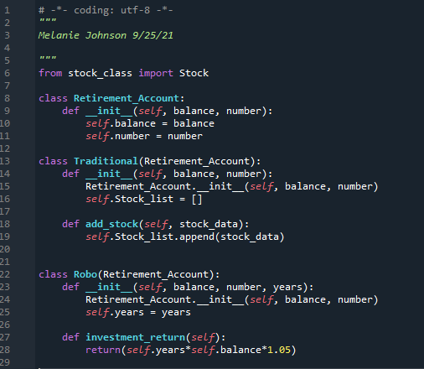
Inherited classes
Paste a screen shot of your classes

Slide 21
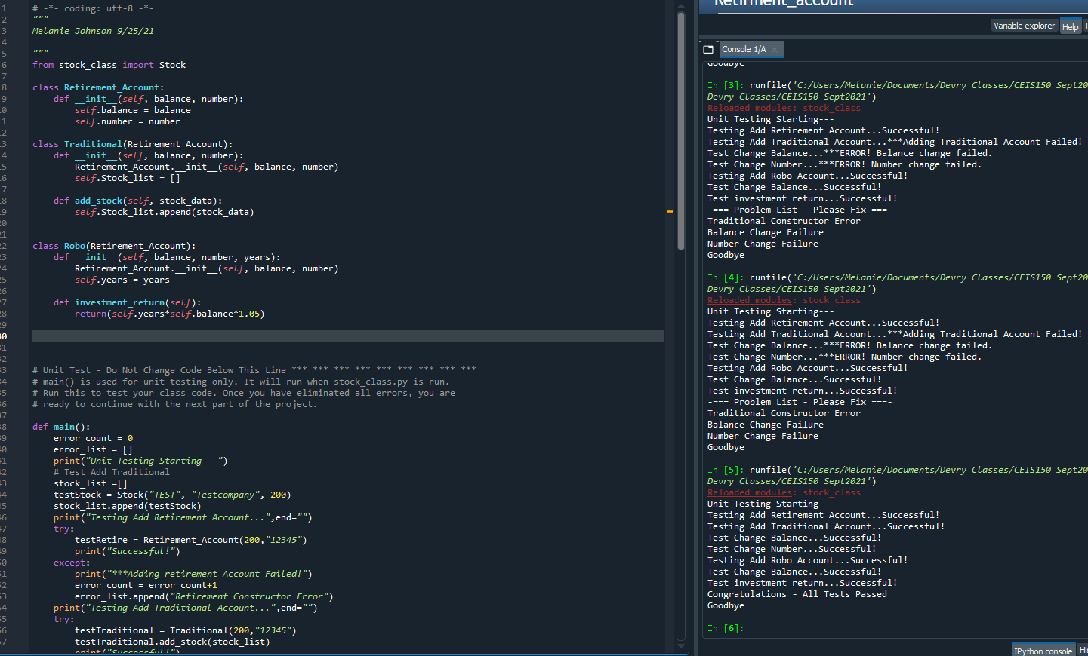
Unit Tests
Paste a screen shot of your unit tests successfully completed

Slide 22
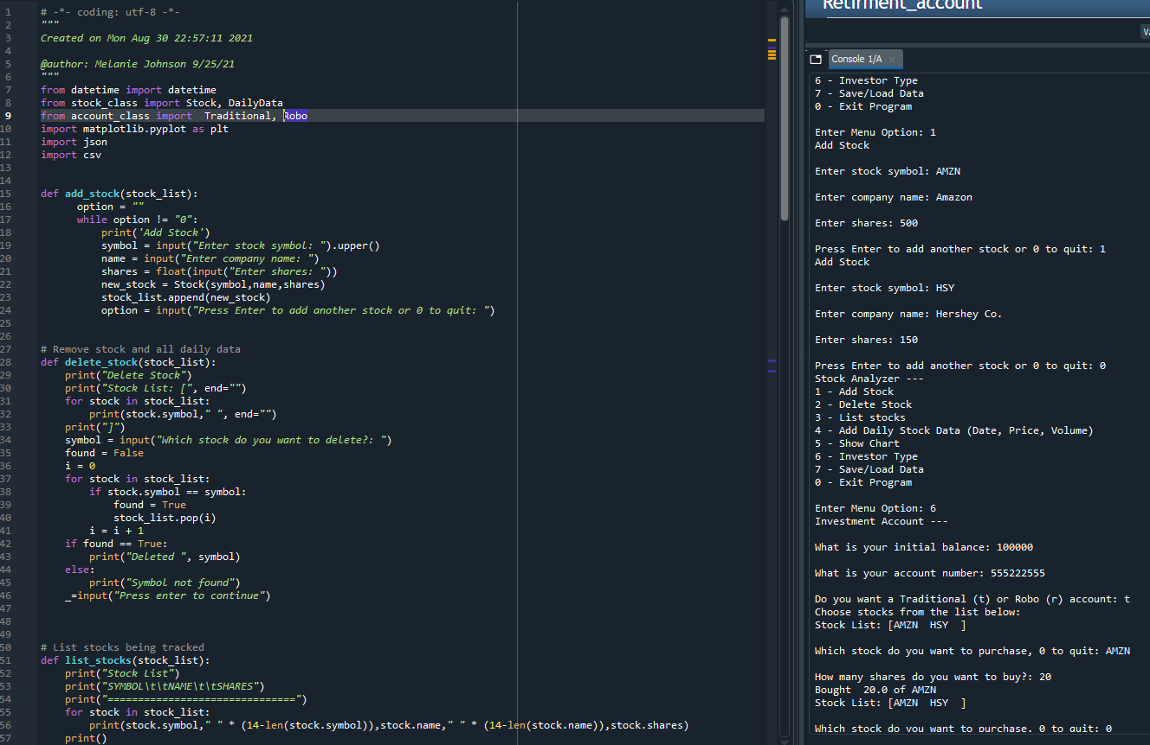
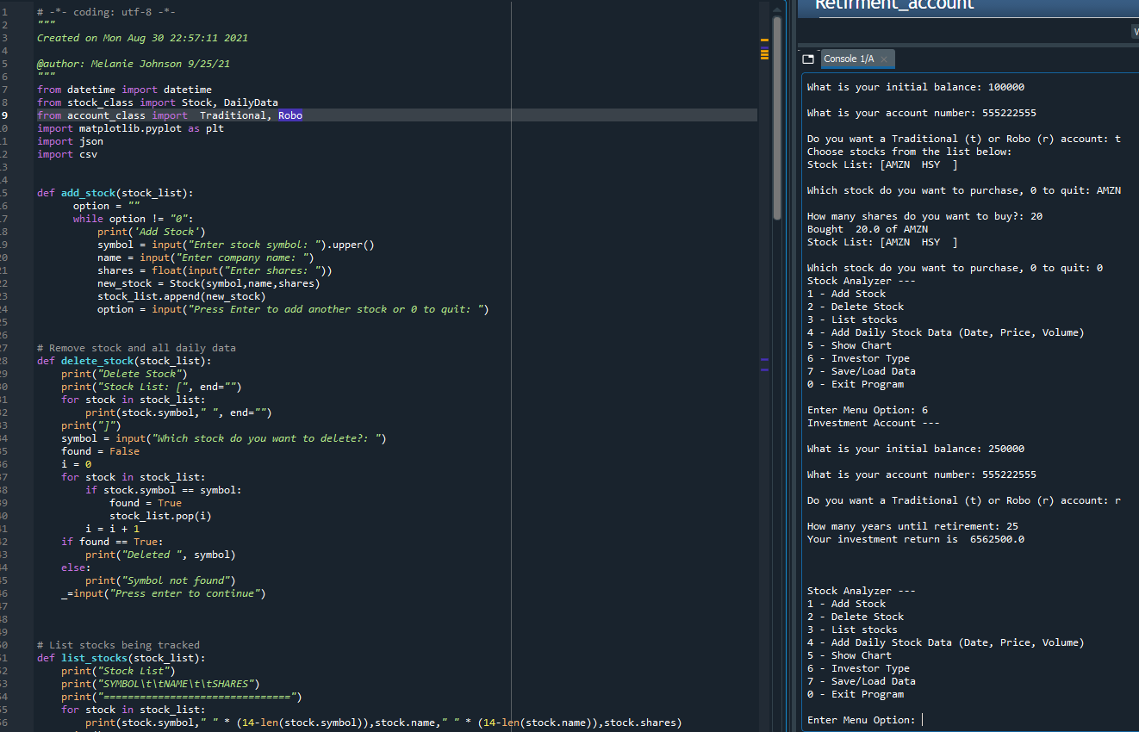
Stock menu program
Paste a screen shot of your classes in the main program
Traditional
Robo

Slide 23
CEIS150 Module 5
Creating a Chart

Slide 24
Rubric
Activity | Requirement(s)
Chart | Screen shot of working Chart

Slide 25
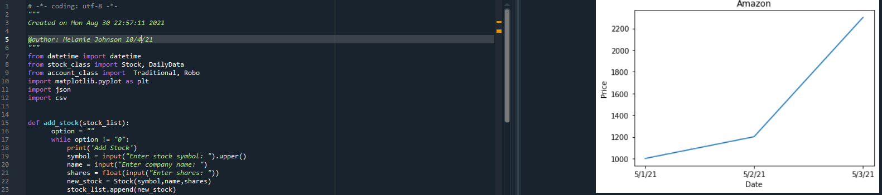
Chart
Paste a screen shot of your stock chart.

Slide 26
CEIS150 Module 6
Saving Data

Slide 27
Rubric
Activity | Requirement(s)
Saving Data | Screen shot of program running and data saved
File | Screen shot of file in File Explorer
Loading Data | Screen shot of data loaded from file
Importing data | Screenshot of daily report from historical data import

Slide 28
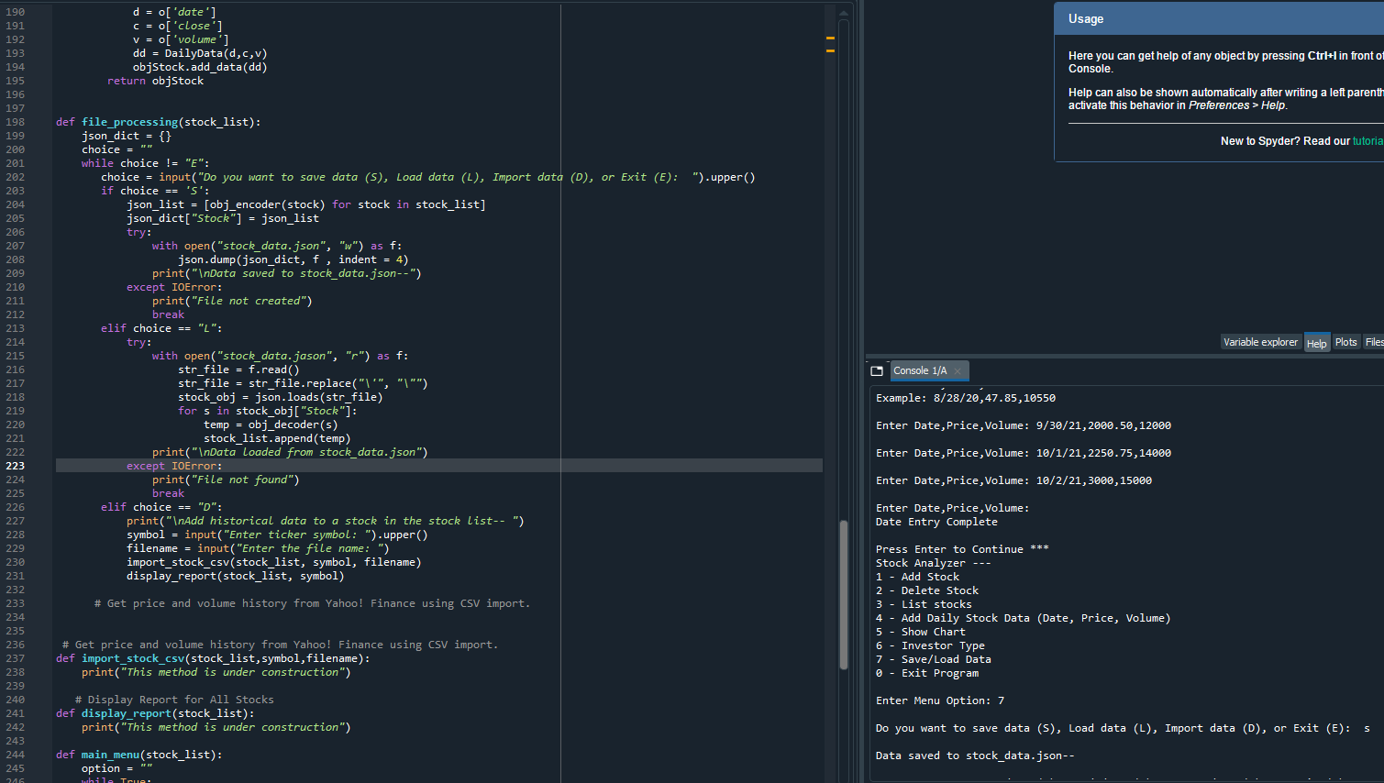
Saving Data
Paste a screen shot of the data saved to a file

Slide 29
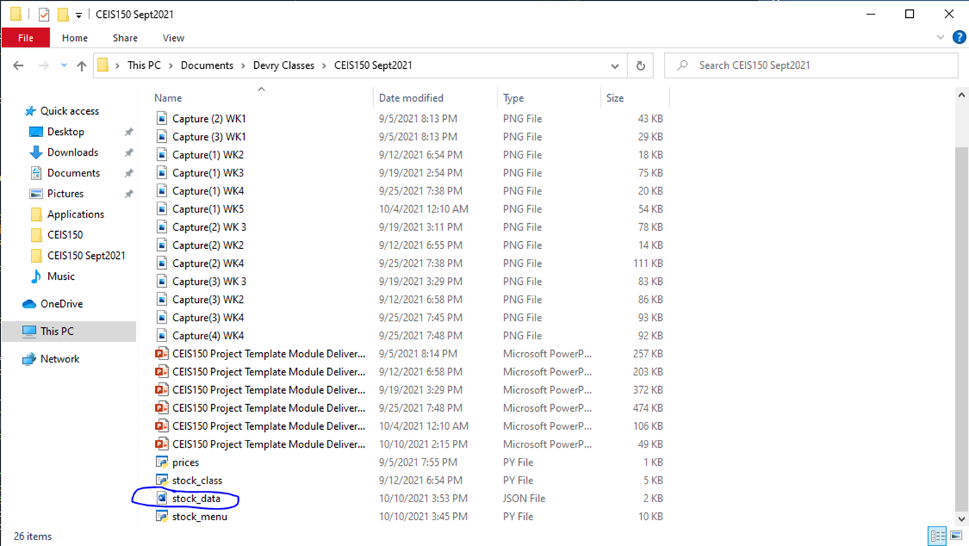
File
Paste a screen shot of the file created in file explorer

Slide 30
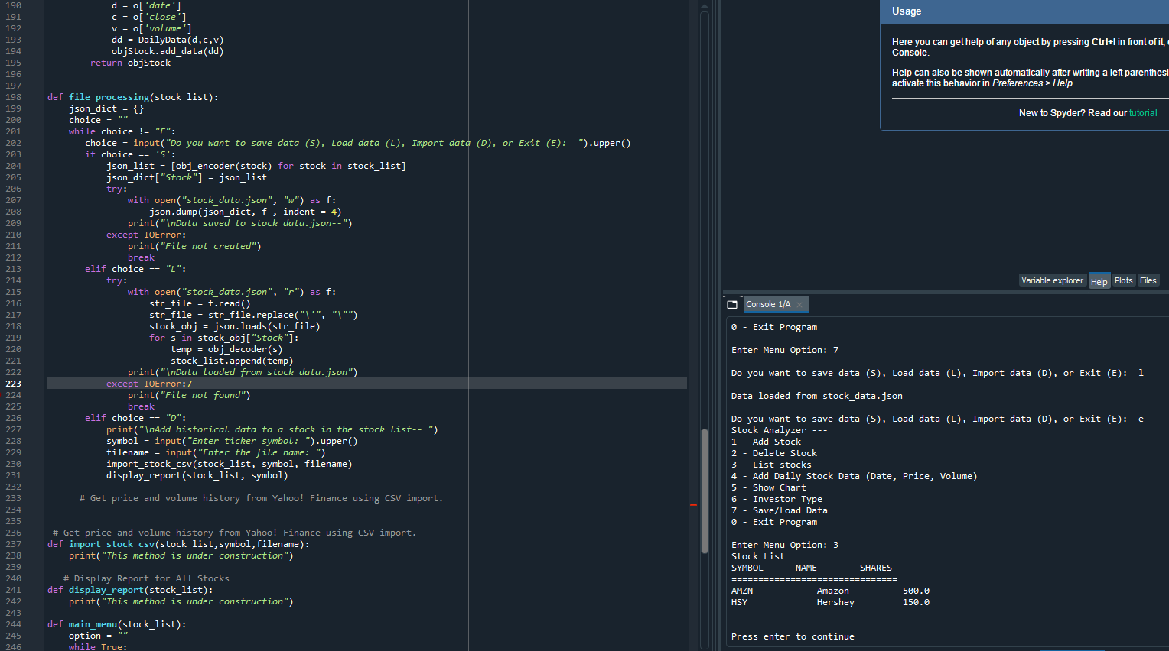
Loading Data
Paste a screen shot of stock listing

Slide 31
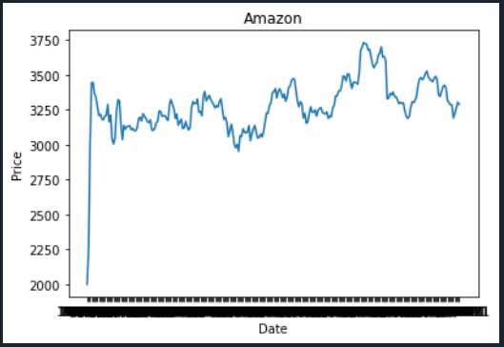
Importing data
Screenshot of the historical data import

Slide 32
CEIS150 Module 7
GUI

Slide 33
Rubric
Activity | Requirement(s)
Stocks in GUI | Screen shot of working program
History complete | Screen shot of working History Tab
Report Complete | Screen shot of Report Complete

Slide 34
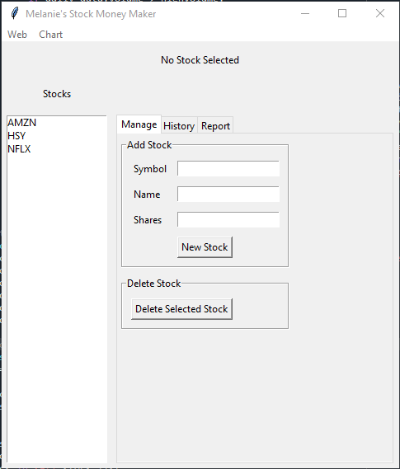
Stocks in GUI
Paste a screen shot of your GUI working

Slide 35
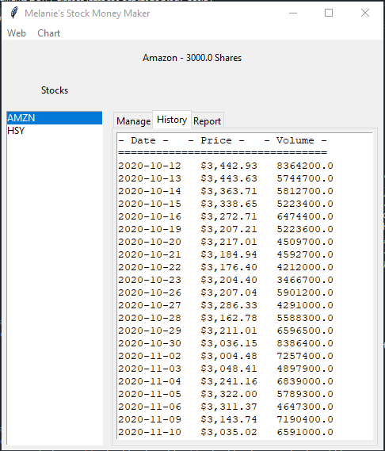
History Tab
Paste a screen shot of your History tab with import working.

Slide 36
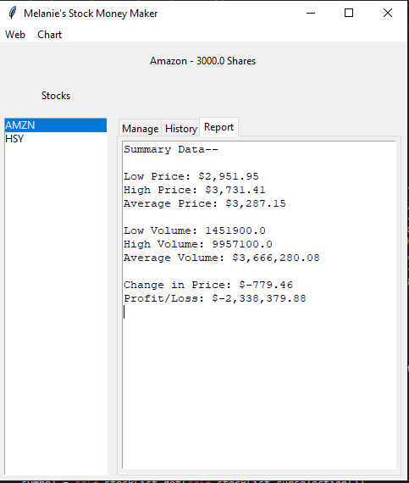
Report Complete
Paste a screen shot of your Report tab

Slide 37
Career Skills Developed
Data analysis
Python programming
Troubleshooting errors
Created graphs with data
Creating GUI program
Using unit tests to test if the program works properly

Slide 38
Challenges
Making sure I had the correct spelling. Often, I would be typing the code and not have the correct spelling. When I would go to run the code, it would have an error because I didn’t use the same name as an object that was being called.
Having the programming files saved in the same folder, so when one program calls from another program that was created it can find the file. It must be in the same directory for it to work.
When extracting data for the stocks it wasn’t in the correct format as the program and was causing an error with showing the data properly.

Slide 39
Conclusion
The project was to create stocks, save stocks, analyze the data and portray it into graphs.
Hands on activity extracted data from yahoo finance.
Used the data from the web to create a graph from a specific stock.
Create a GUI program to enter and save our stocks.
Then a graph can be created from the history of the stock that was entered.
This project had hands on experience with creating a list of stocks, saving the stocks, deleting stocks, analyzing the data and placing this data into graphs.

